Slide 1
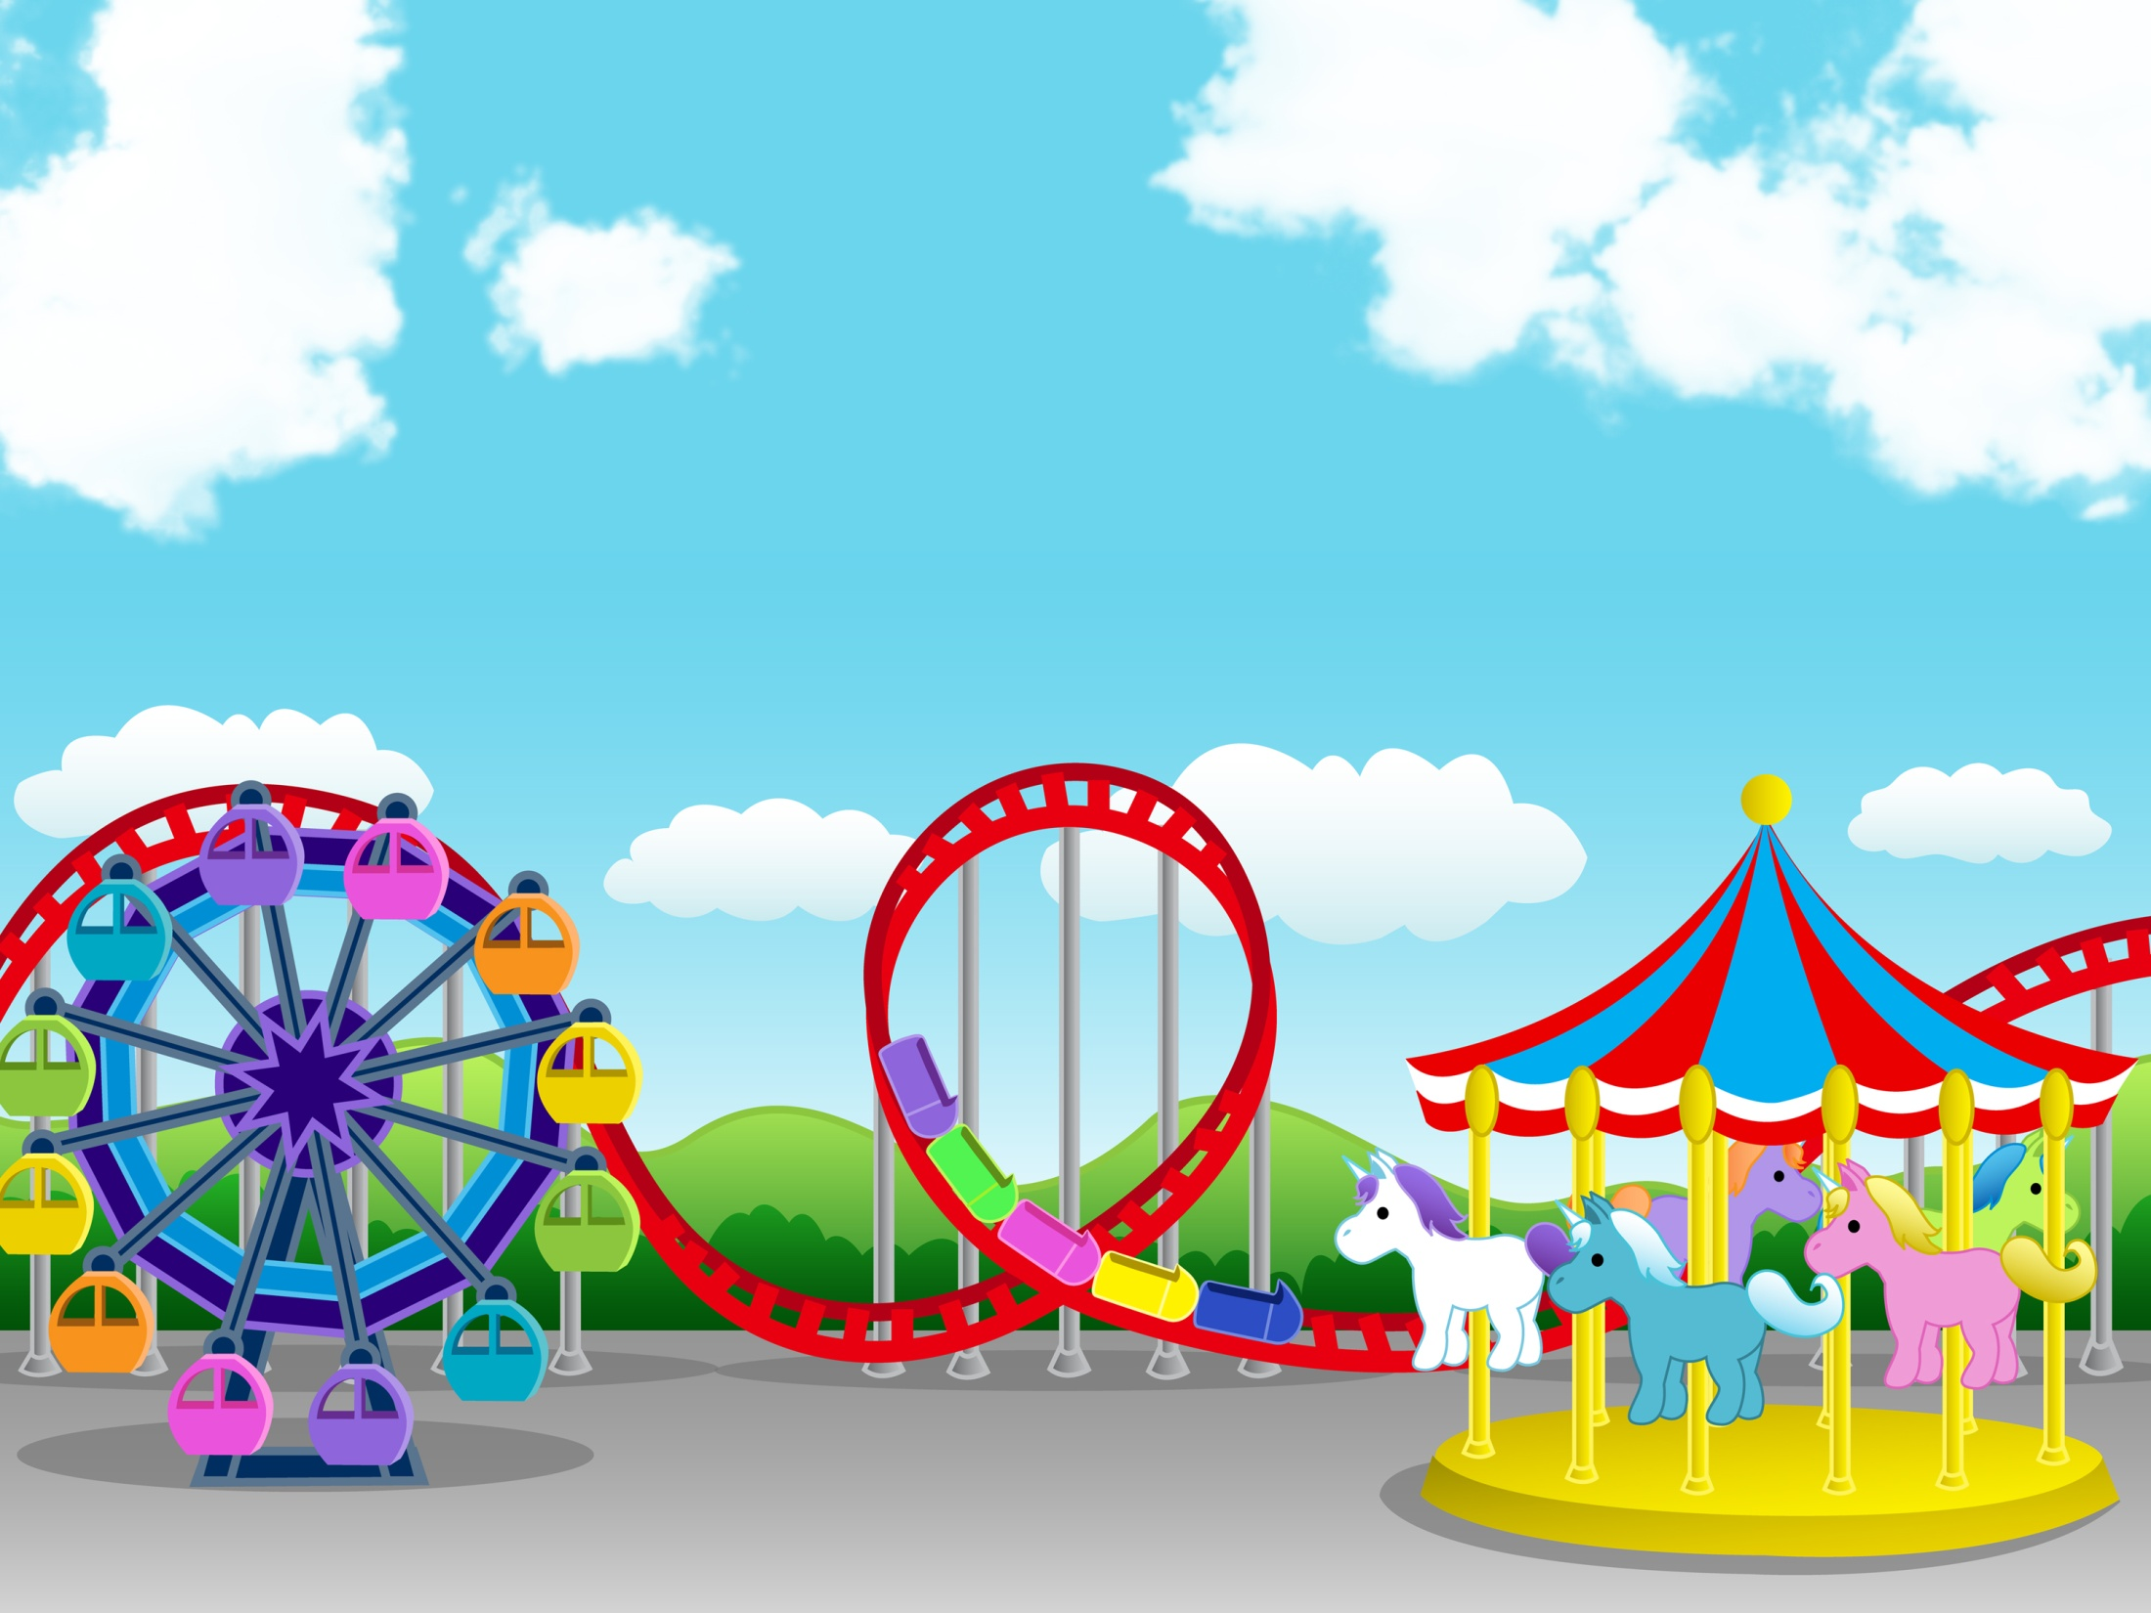
Physics in the amusement park and sports (part 1)

Slide 2
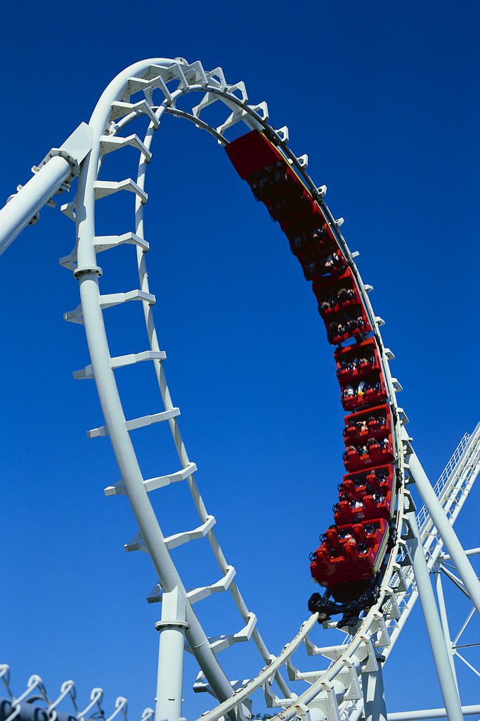
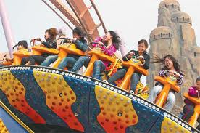
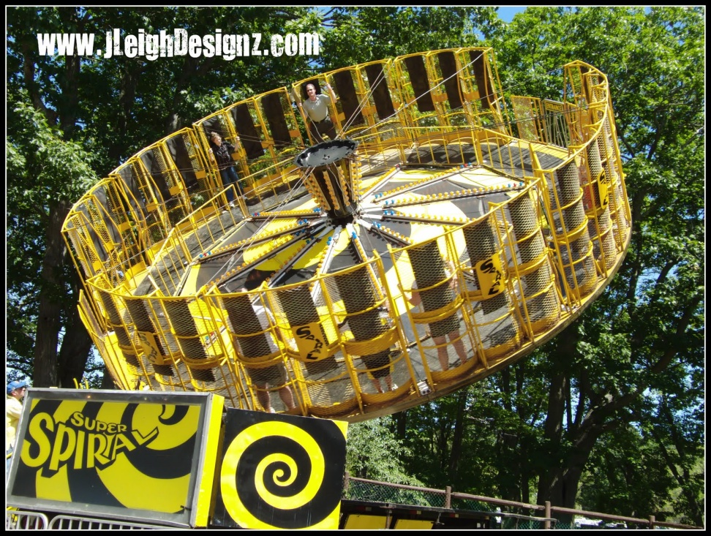
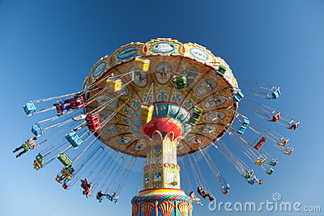
www.chinadaily.com.cn
hotcrossmum.blogspot.com
momspotted.com

Slide 3

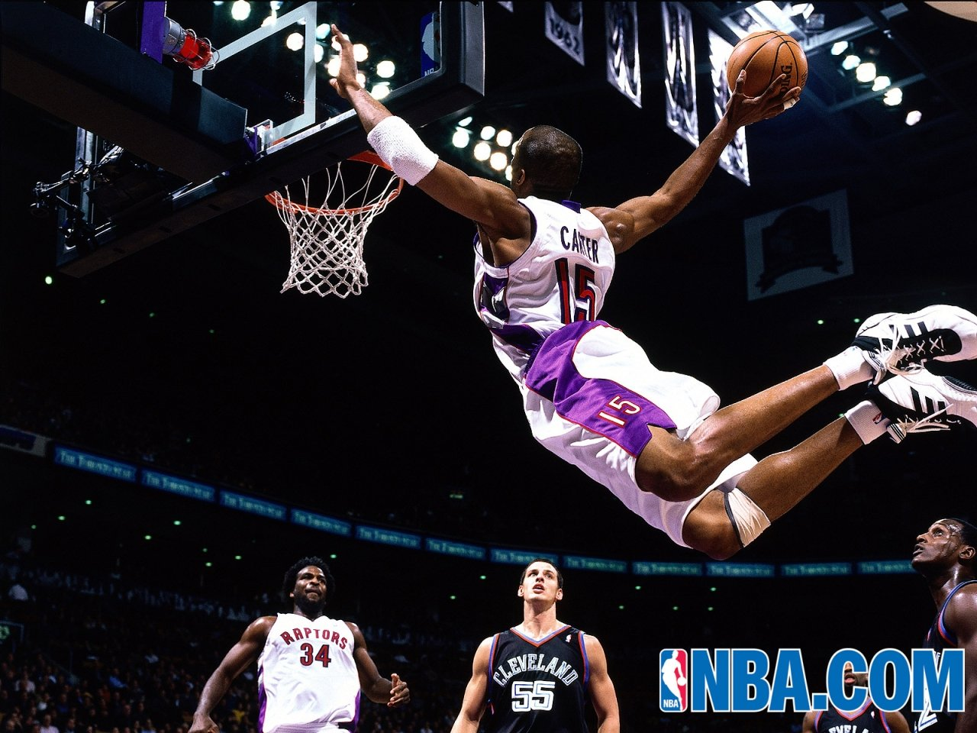
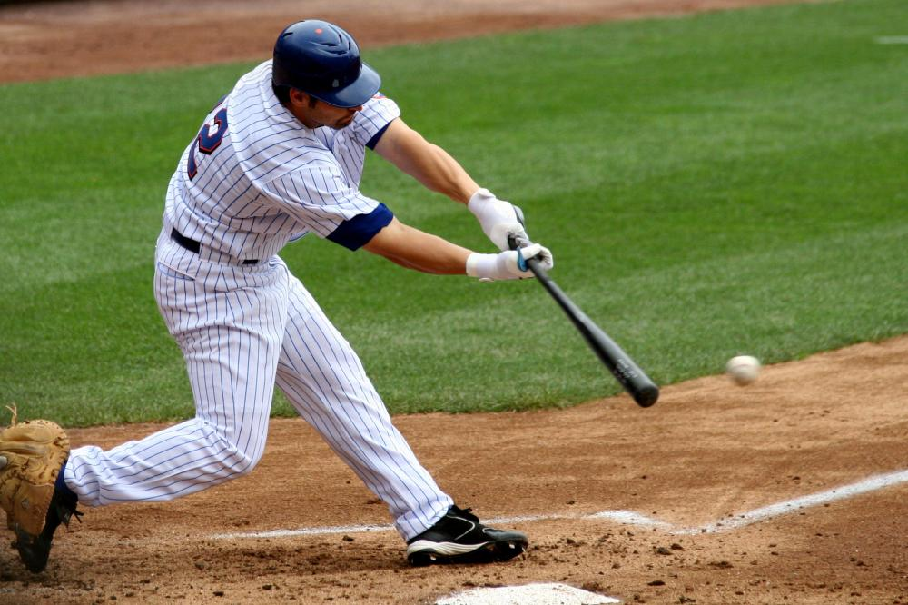

lakewoodfamilybilliards.com
www.hpls.org
baseballequipment.devhub.com

Slide 4
SCALAR
VECTOR

Slide 5
Scalar
magnitude only
Ex. distance, time, speed

Slide 6
Vector
magnitude and direction
Ex. displacement, velocity, acceleration

Slide 7
Scalar or Vector?
100 meters west
20 degrees Celsius
5 Newtons, perpendicular to the surface
300 calories
4 m/s in the opposite direction
Vector
Scalar
Vector
Scalar
Vector

Slide 8
MECHANICS Study of motion
KINEMATICS deals with the description of motion.
DYNAMICS relationship of motion and its causes

Slide 9
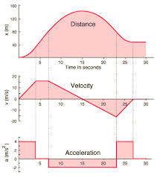
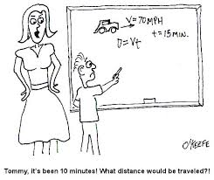
Kinematics
www.engineeringexpert.net
hyperphysics.phy-astr.gsu.edu

Slide 10
Position
the point occupied by an object relative to a reference point;
vector (magnitude & direction)
4 m
A
B
C
(ref)
1 m
Position B = 4 m right of point A
Position C = 3 m right of point A

Slide 11
Distance
total length from one position to another
SCALAR
Units: m, km, cm
4 m
A
B
C
1 m
Distance (A to C) = ???

Slide 12
Distance
total length from one position to another
SCALAR
Units: m, km, cm
4 m
A
B
C
1 m
Distance (A to C)
= 4m +1m = 5m

Slide 13
Displacement
Vector
shortest distance from initial position to final position
For 1D:sign (+/-) signifies direction. + → right or up
A
4 m
C
B
1 m
Displacement = ???

Slide 14
Displacement
shortest distance from initial position to final position
VECTOR
A
4 m
C
B
1 m
Displacement = +3m
(3 m , right)

Slide 15
Example # 1
A
4 m
B
C
1 m
(A →B →C)
Distance =?
Displacement = ?

Slide 16
Example # 1
A
4 m
B
C
1 m
(A →B →C)
Distance = 4m + 5m = 9m
Displacement = -1m
Left

Slide 17
Example # 2
4 m
A
B
C
(A →B →C)
Distance =?
Displacement = ?

Slide 18
Example # 2
4 m
A
B
C
(A →B →C)
Distance = 4m+ 4m = 8m
Displacement = 0 m

Slide 19
SPEED
time rate change of distance
scalar
Units: m/s, km/hr or cm/s

Slide 20
VELOCITY
Time rate change of displacement (position and/or direction)
vector

Slide 21
AVERAGE SPEED
AVERAGE VELOCITY

Slide 22
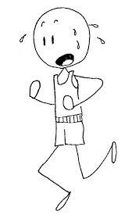
EXAMPLE #1: RUUUN
You sprint 200m in 20 s, then turn around and walk 150m back toward the starting point in 30s. Calculate
(a) your average speed, and
(b) your average velocity for the total trip.
good4sports.wordpress.com
200 m, 20s
B
A
C
150 m, 30s

Slide 23
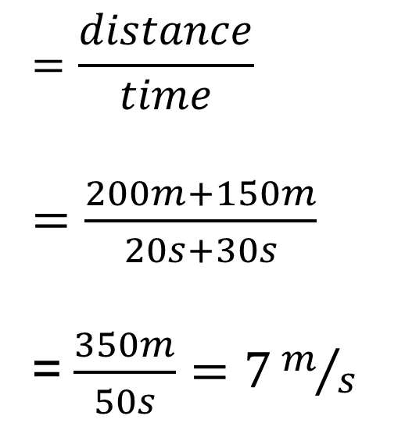
EXAMPLE #1:
200 m, 20s
B
A
C
150 m, 30s
a) Average speed
good4sports.wordpress.com
$$=\frac{distance}{time}$$
$=\frac{200m+150m}{20s+30s}$
=$\frac{350m}{50s}=7m/s$

Slide 24
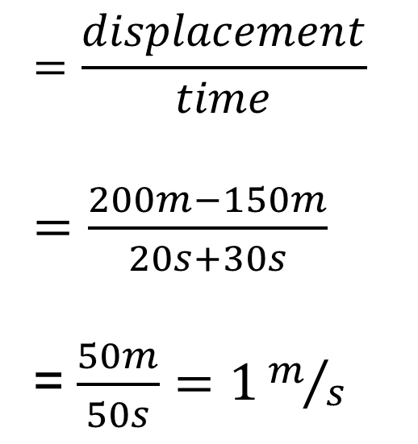
EXAMPLE # 1:
200 m, 20s
B
A
C
150 m, 30s
b) Average velocity
good4sports.wordpress.com
$$=\frac{displacement}{time}$$
$=\frac{200m−150m}{20s+30s}$
=$\frac{50m}{50s}=1m/s$

Slide 25
Example # 2
4 m, 5s
A
B
C
4 m, 5s
(A →B →C)
Average speed =?
Average velocity = ?

Slide 26
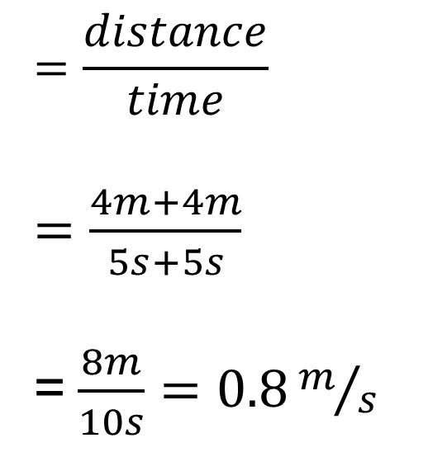
Example # 2
4 m, 5s
A
B
C
4 m, 5s
a) Average speed
$$=\frac{distance}{time}$$
$=\frac{4m+4m}{5s+5s}$
=$\frac{8m}{10s}=0.8m/s$

Slide 27
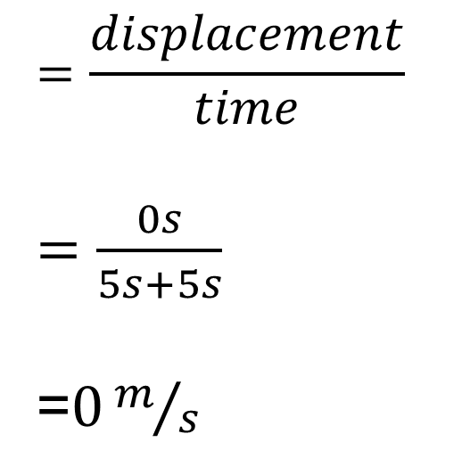
Example # 2
4 m, 5s
A
B
C
4 m, 5s
a) Average velocity
$$=\frac{displacement}{time}$$
$=\frac{0s}{5s+5s}$
=$0m/s$

Slide 28
Instantaneous Speed
velocity/speed at a given instant
The term “velocity” pertains to “instantaneous velocity”

Slide 29
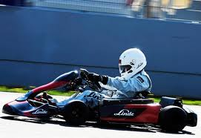
Acceleration
Time rate change in velocity (magnitude and/or direction)
Units: m/s², km/hr²
wordlesstech.com

Slide 30
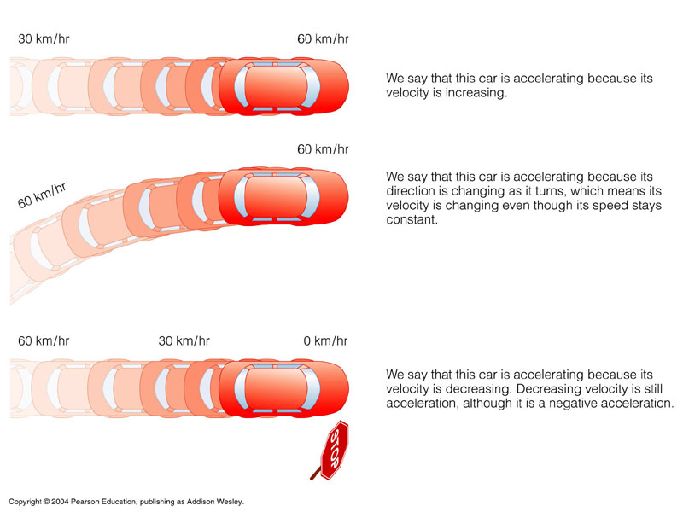
Accelerating or not?
YES – changing velocity (positive acceleration)
YES – changing direction
YES – changing velocity (negative acceleration)
http://anjungsainssmkss.files.wordpress.com/2011/08/fig5-01.jpg

Slide 31
QUESTION #1
Which of the following objects can’t be accelerating?
(1) An object moving with a constant speed;

Slide 32
QUESTION #1
Which of the following objects can’t be accelerating?
(1) An object moving with a constant speed;
ANS: can be accelerating if the direction of the speed changes

Slide 33
QUESTION #2
Which of the following objects can’t be accelerating?
(2) an object moving with a constant velocity;

Slide 34
QUESTION #2
Which of the following objects can’t be accelerating?
(2) an object moving with a constant velocity;
ANS: Can not be accelerating because both magnitude and direction are constant

Slide 35
QUESTION #3
Which of the following objects can’t be accelerating?
(3) an object moving along a curve.

Slide 36
QUESTION #3
Which of the following objects can’t be accelerating?
(3) an object moving along a curve.
ANS: The object is accelerating because it changes direction

Slide 37
Direction
Direction of acceleration → direction of increasing velocity or negative of decreasing velocity
Increasing velocity
1 m/s
10 m/s
acceleration
Decreasing velocity
10 m/s
1 m/s
acceleration

Slide 38
AVERAGE ACCELERATION
V_{f} = final velocity
V_{i} = initial velocity

Slide 39
Instantaneous Acceleration
acceleration at a given instant
The term “acceleration” pertains to “instantaneous velocity”

Slide 40
Uniform Acceleration
Motion with constant change in velocity
Instantaneous acceleration is equal the average acceleration

Slide 41
Note:
constant velocity → acceleration is zero
constant speed, the acceleration is not necessarily zero.
Direction is not necessarily constant

Slide 42
Which is NOT true?
Suppose you are in a car going due east on a straight highway at a constant speed of 30 mph. Which of the following is NOT true?
(a) You and the car's distance is constantly changing (b) Your speed is constant (c) Your velocity is constant (d) Your acceleration is 0 m/s/s (e) Your direction is constantly changing
TRUE
TRUE
TRUE
TRUE
FALSE

Slide 43
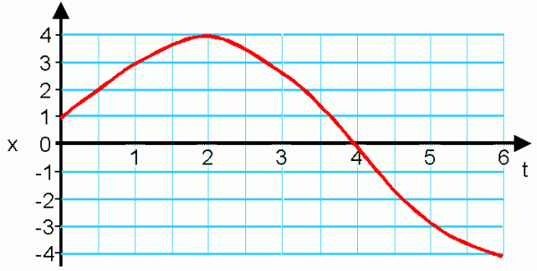
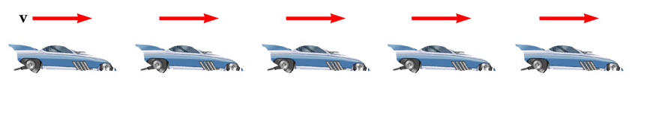
Describing motion with motion diagrams and graphs

Slide 44
Example 1: Motion Diagrams
Uniform velocity (shown by red arrows maintaining the same size)
Acceleration equals zero

Slide 45
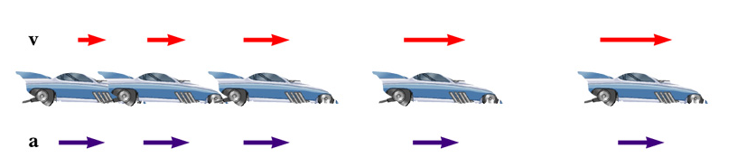
Example 2:
Velocity and acceleration are in the same direction
Velocity is increasing (red arrows are getting longer)
Acceleration is uniform (blue arrows maintain the same length)

Slide 46
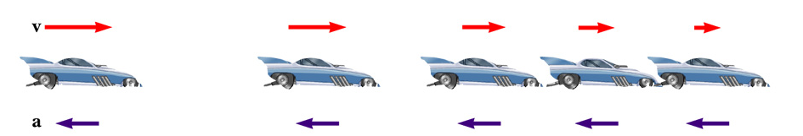
Example 3:
Acceleration and velocity are in opposite directions
Velocity is decreasing (red arrows are getting shorter)
Acceleration is uniform (blue arrows maintain the same length)

Slide 47
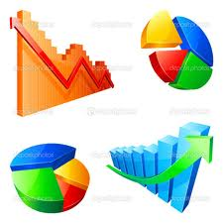
Graphical Analysis
Allows us to see relationships between the independent and dependent variables
depositphotos.com

Slide 48
Different Graphs
Position vs. time (x vs. t)
Velocity vs. time (v vs. t)
Acceleration vs. time (a vs. t)

Slide 49
x vs. t
x
Slope = constant
Slope
= velocity
t
Graph of constant velocity

Slide 50
x vs. t
X
X
t
t
Velocity with
+ direction
Velocity with
- direction

Slide 51
x vs. t
Slope = not constant
Velocity = not constant
x
V = -
V = +
V = 0
t

Slide 52
v vs. t
v
Slope = constant
Slope
= acceleration
t
Graph of constant acceleration

Slide 53
v vs. t
v
v
t
t
Acceleration with + direction
Acceleration with - direction

Slide 54
a vs t
a
t
Constant acceleration

Slide 55
Kinds of motion
Zero velocity
Constant velocity
Constant acceleration

Slide 56
ZERO VELOCITY
x
t
Position doesn’t change

Slide 57
ZERO VELOCITY
v
t
Velocity is zero

Slide 58
CONSTANT VELOCITY
x
Slope = velocity
t
Position constantly changes with time

Slide 59
CONSTANT VELOCITY
v
t
Velocity doesn’t change with time

Slide 60
CONSTANT VELOCITY
a
t
Acceleration is zero

Slide 61
CONSTANT ACCELERATION
x
t
Position changes with time in parabolic manner

Slide 62
CONSTANT ACCELERATION
x
x
t
t
Acceleration with + direction
Acceleration with - direction

Slide 63
CONSTANT ACCELERATION
Increasing slope (magnitude) = increasing speed
x
x
t
t

Slide 64
CONSTANT ACCELERATION
decreasing slope (magnitude) = decreasing speed
x
x
t
t

Slide 65
CONSTANT ACCELERATION
v
Slope = acceleration
t
Velocity constantly changes with time

Slide 66
CONSTANT ACCELERATION
a
t
Acceleration doesn’t change with time

Slide 67
Average Speed or Average Velocity
position, x
time, t
x
Δx
t
Δt
* Concern only on the initial point and final point

Slide 68
Example # 1
Graph the (a) position vs. time and (b) velocity vs. time of a bored student sitting inside a NASC 3 lecture class

Slide 69
Example # 1
Graph the (a) position vs. time and (b) velocity vs. time of a bored student sitting inside a NASC 3 lecture class
x
v
t
t

Slide 70
Example # 2
Which is moving faster?
x
A
B
t

Slide 71
Example # 2
Which is moving faster?
x
A
B
t
Ans: B (higher slope, higher speed)

Slide 72
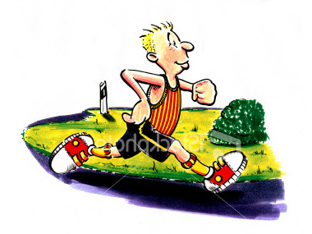
Example # 3: Runner
Graph the position vs. time of a runner, which accelerate from rest, then move with constant velocity and finally, decelerate until he stop.
Constant velocity
acceleration
deceleration
V = 0
V = 0

